Slide 1
PTA Restructuring
Survey Analysis
October 2021

Slide 2
Data Analysis Process
All data was anonymized and sorted into a spreadsheet
Quantifiable data (like responses that could be counted) were illustrated as graphs
Qualitative data (like words and phrases from open responses) was coded by theme and counted to determine typicality or frequency of mention
Themes that were most often named across questions are identified in the final slides
Suggestions and themes most often made across respondents are identified in final slides
Data was triangulated (checked by one staff member and one PTA member) to reduce bias
Any data that identifies specific individuals or is too general to inform strategy (ie “the PTA does a good job”) was removed
Five respondents who provided contact information were randomly selected to receive swag bags as incentive for participation
Quotations from open responses that captured the most common themes for a given question were selected to be shared herein

Slide 3
Participant Data
216 participants
190 parents/caregivers
35 staff (29 instructional; 16 non-instructional)
17 staff members are also parents/caregivers
46% of participants identify as female;10% as male (42% did not provide gender)
4% identify as Hispanic, Latinx/e, and/or Puerto Rican
50% of total respondents did not provide racial identity.

Slide 4
Survey Participation
Participants were nearly evenly divided: one-third who have never participated on the PTA (68); one-third who have (67); and one-third who paid dues but did not participate on a committee (73).
56% found the survey via the PTA email followed by the principal’s newsletter (22%), and then Facebook (15%)
67 participants were affiliated with more than one academy, and 8 were affiliated with all 3.

Slide 5
Consider
With more than 1000 families at Drew, what does this rate of participation (≤15%) tell us?
How does the method of contact and demography of participation help us understand some trends we might to consider moving forward?
How can we contextualize what the participation data might mean—how does 1 or 2 voices in this survey represent a larger population, and how can we hear from more families?

Slide 6
Summary Results By Question

Slide 7
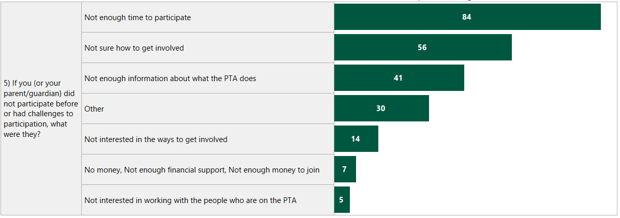
Question 5: Participation Challenges Responses provided by total number of participants who chose a given option.
The most common open response (15 participants) to this question was respondents were new to Drew or arrived at Drew during the 2020-21 school year.

Slide 8
“This comment is relative to Drew and not just the PTA. So please forgive me for extending it beyond the purview of the PTA. Drew is a wonderful school, but getting involved is very difficult. It is somewhat cliquish in nature and the barrier is difficult to penetrate. One example is the Parent Advisory Committee. One of the first questions to the application is how you learned about the committee. The multiple-choice options read something like: a teacher referred you, an administrator referred you, etc. This question is completely irrelevant to a parent's ability to contribute to this committee. But its purpose seems to be directed at ascertaining whether the parent has been preselected by Drew teachers and staff. That is just one example of why parents that want to get involved are put off at the onset by the cliquish culture that is prevalent in Drew and the PTA. I hope this survey and the restructuring will take into account the need to create a more open and accessible environment.”

Slide 9
“The PTA should be more of a voice of advocacy for the needs of parents to the school. The purpose of a "Parent/Teacher Association" is to voice the concerns and issues of the parent body to the school in a way that allows both parents and teachers to collaborate more efficiently. I do not feel that Drew's PTA reflects this within the community. The PTA does not advocate for the needs and concerns for ALL parents in the school community. I have found the school administrators to be unwilling to really hear the voices of parents and only cater to those that tell them what they want to hear. Also, parents of color are often ostracized for advocating for their children, while White parents are embraced when they have concerns. I have heard this several times from many parents. Therefore, parents of color do not have a voice to advocate for them at the school. Since the Drew PTA is made up of predominately White parents who seem to have favor with the administration, it is not seen as a voice either. This effects the overall effectiveness of the organization because since the school is predominately Black, the majority demographic is turned off by the PTA and school administration, which leads to a lack of overall participation."

Slide 10
Consider
What are some new committees or initiatives that could address some of these challenges?
What are structural shifts to the PTA that will need to be made to address these challenges?

Slide 11
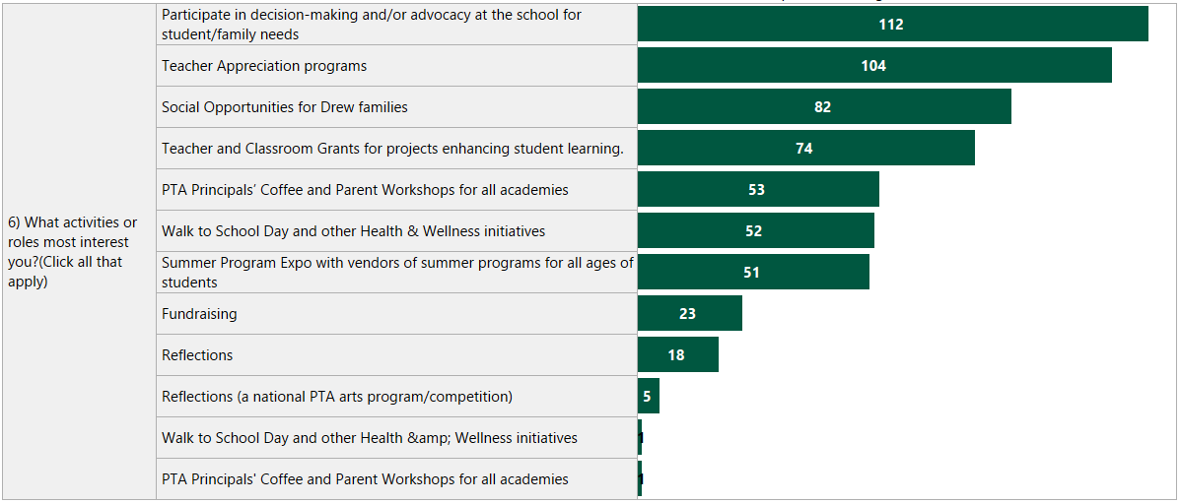
6) What Activities or Roles Interest Most Interest You? Responses provided by total number of participants who chose a given option
Family feedback on school policies/providing safe space for families to provide feedback on their experience and campus safety were the two most common themes in open responses as roles/activities respondents were most interested in that were not listed as choices

Slide 12
“PTA could be the place/entity where families/staff can go to figure out how they can best engage with Drew - in any way that they feel is most meaningful. PTA could be the entrance ramp for how families/faculty can feel a true sense of belonging at Drew.”

Slide 13
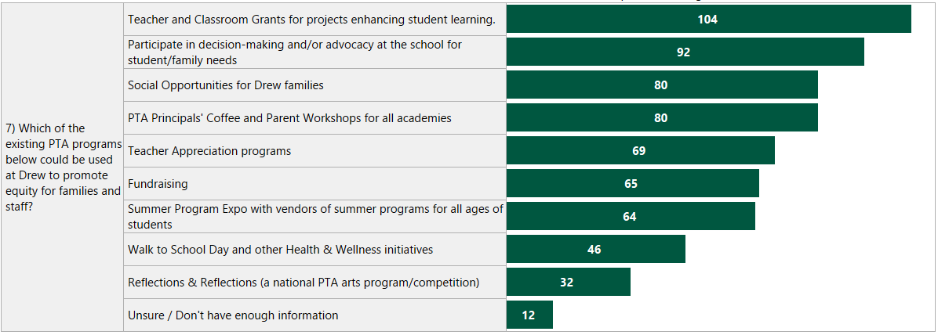
7) Which existing programs can promote equity at Drew? Responses provided by total number of participants who chose a given option

Slide 14
“Outreach so that all families, even those who may feel out of place in gatherings of Drew parents - the families who live in the villages seem to be under-represented in the PTA (from my outside looking in perspective.”
“Not have mainly white members and do events like an auction, which is primarily an event for middle to upper class parents.”
“Work to eliminate racial division in the Drew social network. The PTA family activities can be unappealing to parents that don’t have a connected network at Drew. Families tend to naturally associate with their clique, which tends to be racially based.”
“I don't understand this question because I am just a parent, not an expert in education policy. I agree equity is important to strive for, but honestly, I feel like this is something that is a burden of the school, not PTA, to figure out and hasn’t.”

Slide 15
Open Responses to Build Equity
19 responses included “unsure” or questions like “what is meant by centering equity” or “I don’t understand this question.”
Major equity themes centered on the demographics of PTA leadership matching the demographics of the school AND amplifying the needs and voices of “working families”

Slide 16
8. How could the PTA do more to center equity?
More outreach/presence/improved communication
Racial and cultural representation of families on PTA leadership team
Frequent, regularly-scheduled community-building events by class, grade level, academy
Speaker series and facilitated discussions (”chat and chew”) on topics of interest
Ensure format (time, platform, communication) consider different types of families and schedules with all events
Remove costs associated with membership and participation
Regular feedback collection from the community to understand community needs

Slide 17
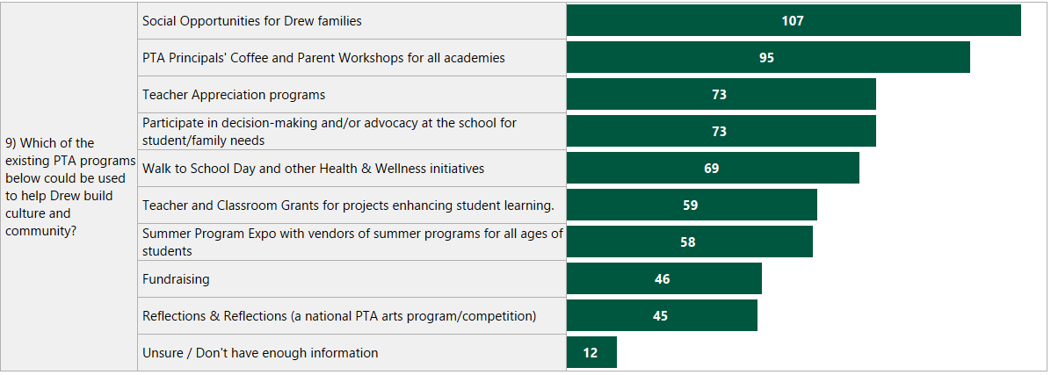
9) Building Culture and Community Responses provided by total number of participants who chose a given option

Slide 18
Open Responses to Building Culture and Community
12 respondent said “unsure”
Major themes focused on connecting families, connecting families and staff, and creating more ways for families to be involved in the school as volunteers

Slide 19
11) Exciting PTA Initiatives?

Slide 20
“Social events to get to know other parents and students in their grade….so it could be once a month [third] grade meets at Bessie park with a specific date from 4-7 or something. Then it is mostly all the third grade parents and their siblings talking and playing.”
“Providing feedback and thought partnership to school staff on the impact of school policies and programming”

Slide 21
12) What should the PTA be doing that it is not?
4 responses from staff indicated more opportunities for staff engagement
7 responses related to amplifying parent voice to inform curricula, policies, board decisions, communication strategies
3 respondents didn’t know what the PTA is doing now
5 respondents provided affirming feedback on current programming
7 or more responses spoke to the importance of events to be scheduled regularly (monthly, weekly, on a calendar) and to be communicated on a calendar for predictability and frequency

Slide 22
“In light of the recent loaded weapon incident, there seemed to be minimal communication from all parts of the school and nothing on going to help parents understand what is being done to keep Drew a safe and productive learning environment for our children. Communication of current and future plans for all parents need to be better communicated. With Covid, new families to drew, such as ours, feels left in the dark and left out of this exclusive fraternity. There has been poor and minimal engagement with new families and that needs to be addressed.”
“I haven't been at Drew very long and do not know the specifics of the way the PTA has functioned here. However, I think any initiative focused on bringing new activities that give parents a chance to be more involved, and efforts to keep parents more informed would be good things.”
“There is a lack of connectivity. Perhaps some don’t feel it and some do. I’m not sure how to fix it but hopefully we will take this opportunity to address it.“
Considering Communication

Slide 23
Considering Staff
“Support familiar struggling to survive. Support teachers who are solo and teaching over 100 students a day. Find parents + grandparents who need work + train them to be literacy coaches + math coaches.”
“Wondering if there should be an outreach effort to engage more staff with the PTA? As a staff member with no kids at Drew, I haven't really heard about what the PTA does aside from the kind tokens of appreciation, but would be curious to learn more. “
”The PTA in its current incarnation feels really divested of power in the school community as far as engaging in activities that address unique challenges of Drew. There also seems to be limited engagement from staff — how can PTA evolve in a way that feels more collaborative with teachers?”

Slide 24
“Opportunities to participate and evaluate equity and fairness in all policies, communicating information about PTA meetings or school board meetings and and ways to allow our voices to be heard. I only hear about the fun stuff like decorating the side walks or park play dates but want to be involved in every aspect, particularly things that impact our children and their diverse experiences.”
“Supporting culture and equity by promoting school-home communication and staff/family collaboration. The PTA creates a feedback loop so staff can understand how the program is working and how it needs to be adjusted. Issues [of] equity and culture are best measured by feedback from families and students. That feedback is missing. The PTA can provide that voice and advocacy for families/students and protect them from the blowback of the staff and admin.”
Considering
Equity

Slide 25
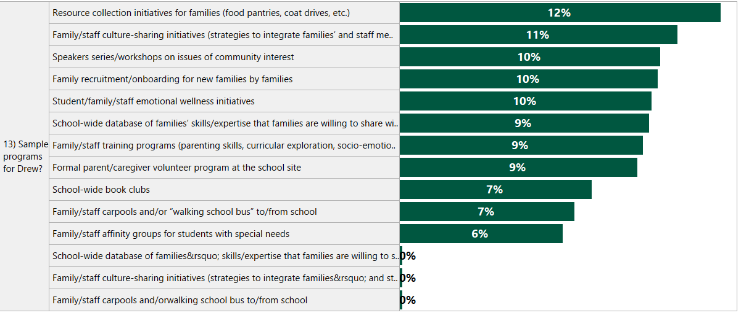
13) Sample Programs for Drew?

Slide 26
Recommended Initiatives
Speaker Series
Safe Routes to School
Local Business Mentorship Program
Parent/Guardian Tutoring Program
Family Members as In-Class Volunteers
New Family Onboarding—Returning Family ”adopts” a New Family
Grade Level Social Events
“Room Parents” for 6th-12th grades
Teacher-led monthly workshops
Speaker series with facilitated discussions (”chat and chew”)
Community Service bank/facilitated community service opps for students and families
Foundation for increased/improved school technology
Advocacy for revised lottery process for the school
Parent rep to school board
Uniform clothes closet
Resources for families in need
Supplies for classrooms
Funding for arts classrooms
Funding for arts and sports programs
Free PTA membership for all
Holiday multi-cultural celebration
Monthly cultural awareness assemblies/events
Monthly community town hall
Annual social events calendar for families
Social events by zip code/neighborhood
Family support groups by special interest
Family resource/skills list for the school to utilize
Train caregivers to be paid content tutors
Wellness initiatives for teachers/staff

Slide 27
Trends in Data

Slide 28
Area of Focus: Engaging Diverse Families
Theory of Change: Improved communication, intentional outreach to under-represented families, greater visibility/recruitment of existing membership, and reorganization of opportunities that resonate with under-represented families will increase diversity of membership/leadership
Possible strategies:
Communication (see communication focus area)
New committees and focus areas to grow purview (provide opportunities to engage beyond event planning, fundraising--criticism of current opportunities)
Structure, systems (record keeping, timelines) to support new member onboarding—systems in place to capture committee roles, processes, so onboarding is less of a “hand-off” reliant upon two individuals
Regular, frequent advertisement of engagement opportunities and means to advocate for new initiatives, start committees, etc.

Slide 29
Trends: Challenges to Resolve
Conflating school challenges with PTA: “The communication process could perhaps use some fine tuning. Families are using Google classroom, Apex, Georgia Virtual, RemindMe, blogs and emails. It’ becomes a bit overwhelming and still things fall through the cracks.”
PTA demographics: perceptions. recruitment challenges, and the implications on membership: “Not have mainly white members.” “PTA membership should match the demographics of the school.”
Communication: “Include timely notice and a variety of correspondence regarding ways to get involved.”
Confusion about the PTA’s role: Frustration for families who want support from the Eagle Tree, don’t believe athletics and enrichment is inclusive, or feel admin isn’t approachable is attributed to the PTA not doing their job. Gaps in equity and family voice--these are PAC, PEC, OF roles. The PTA’s role must be clearly defined.

Slide 30
Trends: PTA Structures
The PTA needs more community voice to determine direction (better communication, more engagement, greater diversity)
Partner with staff to understand their needs
More engagement at JA/SAs to match engagement at EA
Advocacy for curriculum and instruction, enrichment that is high-quality, equitable, representative (is this a PEC or PAC initiative?)
The PTA’s leadership needs to match the demographics of the school
More frequent, regular, accessible communication and opportunities to engage
More social activities for students at each grade level (is this a school initiative?)
Regular, predictable calendar of events to plan volunteerism and participation
Regular, predictable means of communication (where to find things, how to reach people) so we know what is happening, who to contact, and PTA communication is aligned to that of the school
Community skills/resource list
Amplify Black voices

Slide 31
Trends: Committee Work
Staff appreciation/support
Creating space for families to volunteer and be engaged at school (parents/caregivers as volunteers)
Opportunities for families to connect and get to know each other (and the staff) outside of the classroom (social events, speaker series, support groups, facilitated discussions, etc.)
Campus safety (parking lot, weapons safety, playground, safe routes to schools)
Mentorship of new families by returning families—onboarding for new families and new family/returning family matching
Opportunities for students and families to engage in community service
PTA Teacher/Staff Committee to inform staff needs and drive staff programming/engagement
Means for PTA to collect family feedback and advocate on behalf of families to the administration for issues of concern to the community/inform policies and school structures
Communications committee to oversee distribution of information, regular updates, collection of feedback, ensure community inquiries are managed and directed to the right places (partner with school)

Slide 32
Consider
Where do we need support from admin, staff, other bodies?
What are longer-term goals that will take time?
Where can we get started with light lifts and quick fixes?
What are 2-3 activities that YOU are personally interested in engaging in?

Slide 33
Focus Areas

Slide 34
Area of Focus: Communication
Theory of Change: Partnership with the school to create more streamlined, responsive communication will ensure all community members can dialogue with the PTA to engage authentically, increasing participation and diversity of membership.
Possible strategies:
Creation of PTA communications committee to manage regular outreach, website, check emails, foster dialogue
Dedicated PTA email/VM that does not change year over year (ie info@drecharterpta.org and a Google voice number)
Partnership with designated communication staff at the school to resolve communication challenges using feedback from the school community
Regular updates from the PTA in a predictable format (newsletter, blog, etc.)
Volunteer coordinator or similar position on PTA to help interested community members find means of engagement and/or connect with the resources they need
School-wide commitment (from PTA, admin, and staff) to response times to family’s email inquiries (all emails receive reply within 2 working days, 3 working days, etc.)
Virtual ”suggestion box” (standing email) to collect community ideas and feedback, monthly town halls and focus groups, livestreamed monthly teacher presentations

Slide 35
Are of Focus: Leveraging What Works
Theory of Change: Build on the existing programs that are successful to grow membership and expand the impact of the PTA.
Possible strategies:
Expand “Room Parent” program to JA and SA (increase engagement of upper campus families and staff)
Create “Teacher and Staff Appreciation” sub-committees for each campus to ensure similar coverage and communication about appreciation events
Empower ”Room Parents” to collaboratively organize grade level events with support from school admin
Partner with Opportunity Fund and counseling staff to make resource lists available for families in need
Add PTA events to the school calendar for the year so social events are visible on the school website

Slide 36
Area of Focus: Community-Building
Theory of Change: Provide opportunities for family-school collaboration and family-to family engagement to build school community.
Possible strategies:
Regular calendar of virtual or “safe” events that can be held by campus or grade level in current climate
New family onboarding and mentorship by returning families
Expansion of room parent program to upper campus and formalization of event-planning for classrooms
Monthly virtual workshop/speaker series with round table
Monthly focus groups with parent liaison
Family-family affinity groups (special education, families of athletes, families of artists, families by neighborhood, etc.)
Staff PTA sub-committee

Slide 37
Feedback for School Admin

Slide 38
Trends in Feedback for School Admin
Families need anonymous, parent/family-based space to provide feedback on school programming to be brought to admin. (specifically named concerns about negative relationships with admin, personality conflicts with admin, or other perceptions of barriers as to how admin receives families’ feedback or communication that a parent-based body mitigates)
Families want community-building: means to bring families and families and staff together outside of the instructional space to build school culture and pride
New families need onboarding/mentorship programming to learn about the school and feel included
The school’s communication approach is not currently working for all--need for streamlined communication (too many platforms, unclear what information is where)
Need for feedback loop to school on impact of programming and policies used to inform revision to programming and policies

Slide 39
Possible Strategies
Organize family focus group/community working group to improve communication (hire expertise to facilitate and problem-solve using direct feedback from community members on communication barriers)
Create a succinct, clear message about the three advocacy bodies (PEC, PAC, Opportunity Fund, and PTA) and publish these with the three contact emails/VMs on all channels (principal newsletters, website)
Identify community-building strategies to be led by the school and which will be supported by the PTA (new family onboarding, grade level events, room parents, etc.)
Create a means for families who need support to request that support—confusion about how to get Eagle Tree or other funding help has conflated this

